Slide 1
SMART TRANSIT SYSTEM
A boon for Smart Cities
RAJALAKSHMI ENGINEERING COLLEGE
Team Members
Guide
S. Vignesh babu
M. Varun
Dr. K. Devaki
Professor

Slide 2
Objectives
To provide a mobile application for smart transit system by integrating information technology
Giving insights to the passengers about the bus’s proximity, seat capacity and Estimated Time of Arrival (ETA).
Optimizing the number of buses in certain routes with the data collected from the mobile application using data mining processes.
To optimize the cost and thereby increase the revenue.

Slide 3
Introduction
Cities are engines of growth for the economy of every nation, including India.
This requires the comprehensive development of physical, institutional, social and economic infrastructure, Development of Smart Cities is a step in that direction.
Public transportation system is the lifeline of the residents.
The current metropolitan transport corporation(Chennai) has around 3866 buses and an approximate estimation of 48 lakh people travelling per day using this transport service.
The government is seeking all possible measures to increase the profit obtained through public transport and also to cater the people’s need.

Slide 4
Introduction
This model introduces a mobile application to provide clear information about the bus, to the commuters availing the transport system in advance so as to avoid inconvenience in their travel.
Hence, a new method has been proposed using technologies like Raspberry Pi, AVL (Automatic Vehicle Location) using inbuilt GPS, cloud computing and data analytics, to provide optimization of the number of buses in operation, insights about the bus proximity for the commuters, decrease in fuel expenditure and eventually reduce the emission of harmful air pollutants and greenhouse gases from the vehicles.

Slide 5
Literature Survey
Nouf Mohammad Al Shammary and Abdul Khader Jilani Saudagar,
”Smart Transportation Application using Global Positioning System”
(IJACSA) International Journal of Advanced Computer Science and Applications, Vol. 6, No. 6, 2015
PROS:-
Provides shortest route between source and destination.
Displays approximate time of travel
Advanced reservation and seat availability details through short message service (SMS)
The application is based on GPS and GNSS using mobile interface to access the information.
CONS:-
Real time seat availability between any two stops is not calculated so it can result in replication of seat availability.
No optimization measures taken for the transport vehicles

Slide 6
Literature Survey
Hans-Arno Jacobsen, Kaiwen Zhang, Yingqi Yue,
”Smart Phone Application for Connected Vehicles and Smart Transportation”
Middleware 2013 Posters and Demos Track, December 9-13, 2013, Beijing, China
PROS:-
Uses image processing and sensors installed at highways and signal to detect traffic congestion.
It also gathers information about road conditions and time gap to move to next place according to GPS, to access the traffic intensity.
CONS:-
Doesn’t deal with seat availability and estimate time of boarding.
No optimization for transport vehicles done in this project

Slide 7
Existing System – Drawbacks
Today’s existing system implements each of the features independently, most applications are based on traffic analysis but doesn’t consider the ease of access to the customer.
These data is often not recorded to gain useful insights. The availability of seat in a particular bus route at a particular time and the demand for a particular route is often neglected.
The supply of seat in a selected bus path at a selected time and the demand for a specific course is frequently not noted.

Slide 8
Proposed Method
Smart Transit System provides user interface through the users mobile as well as a touch screen installed at the bus station.
The GPS installed in each bus sends signal about its location to a centralized server, the server then provides information about the bus to the commuter's user interface for the user to plan their travel.
The seat availability is monitored and updated through the conductor's user interface (smartphone- web application).
Each request by the commuter is recorded in the centralized server to analyze the aggregated data and use time series analysis to identify the demand and optimize.

Slide 9
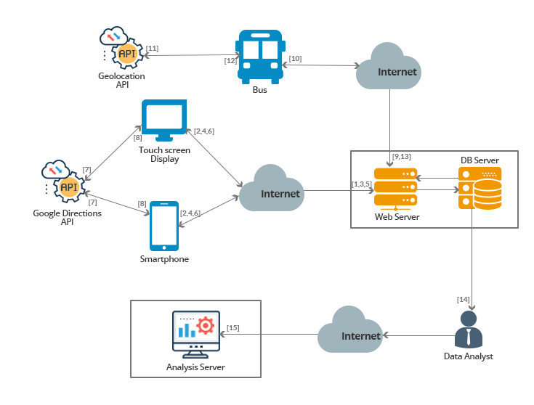
Architecture Diagram

Slide 10
Component Description
1
2
3
Bus Proximity Identification
Booking and AVL
Bus Frequency Optimization and Data Analysis Interface

Slide 11
Bus Proximity Identification
This component can be accessed by web browser through a touch screen display supported by the Raspberry Pi device or through an app installed in the personal smartphone of the passengers.
It accepts the boarding and leaving points submitted by the user.
The list of buses which has the matching stops of the boarding point and the leaving point in its route of navigation are shown.
The user can select any one the bus from the list displayed.
The info related to the selected bus which includes the bus’s proximity, number of free seats and estimated arrival time of the bus to the boarding point are displayed to the user

Slide 12
Bus Proximity Identification
Web Server
Http Request/Response
Smartphone Display
Send latitude and longitude details to Google Maps Directions API.
Render the location markers in the mapView
Get Bus numbers matching the source and destination stops
Get number of free seats
Get bus proximity
Get bus latitude and longitude
Database Server

Slide 13
Algorithm
Input: Boarding_stop, Destination_stop, Database D
Globals:
const Bs: Boarding_stop
const Ls: Leaving_stop
const TS: Total number of seats in the bus
TBC: Total_boarding_count = NULL
TLC: Total_leaving_count = NULL
Bc: Boarding_count
Lc: Leaving_count
Output: Free_seats, available in the bus

Slide 14
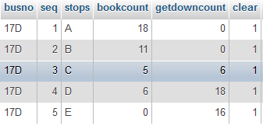
Algorithm
Method:
(1) Fetch the Bc and Lc from the D
(2) Calculate sum of Bc and Lc
for (i=1; i<Bs; i++)
TBC = TBC + Bc[i];
TLC = TLC + Lc[i];
(3) To calculate the free seats
Free_seats = TS – TBC + TLC

Slide 15
Booking and AVL
The bus conductor can access this component through the app installed on their smartphone
Login details has to be entered to enter into the booking page.
.The conductor can enter the boarding point, leaving point and number of seats requested by the passenger and has to submit those details
Automatic Vehicle Location (AVL)
The latitude and longitude of the vehicle are found, either, by using inbuilt GPS of the smartphone device or by cell tower triangulation method using the Geolocation API of the World Wide Web Consortium Recommendation
AJAX technique is used to periodically update the bus’s latitude and longitude to the Database

Slide 16
Booking and AVL
Web Server
Http Request/Response
Conductor Smartphone
Update the latitude and longitude details of the bus.
Update the number of seats available in the bus.
Database Server
Identifying GPS position using geolocation API
periodically through AJAX

Slide 17
Analytic Interface - Procedure
Each search through the user interface - either using the device at the bus stand or the web application in the mobile device- is stored in the server.
The person at the admin end will open the cloud account and download the data which is accumulated.
After successfully downloading to the local device the algorithm is run on that particular data set.
An analytical interface is created using shiny-R framework to visualize and infer insights by using Time Series Analysis and Regression
The analytical interface or the admin panel consist of some predefined functions to analyze a part of the data and visualizing the result.

Slide 18
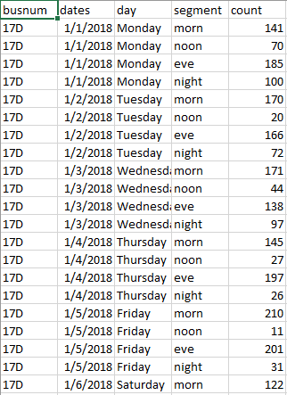
Analytic Interface - Dataset

Slide 19
Analytic Interface - Trend Analysis
The interface consist of Time series analysis which runs on the accumulated data, predicts the trend for the next few days.
Autoregressive Integrated Moving Average algorithm is used to predict the trend.
This predicts the maximum, minimum and the expected trend for the total tickets in a graphical format.
Graphical format will enable the transport department to easily infer the trend expected.

Slide 20
Analytic Interface - Bus count estimation
The interface also provides with a facility to estimate the optimal count for a bus number to fly at a particular time interval.
Random Forest Regression is used to accurately obtain the optimal count of buses.
Only the latest 28 days are considered to estimate the count to provide an optimal count.
The user selects the day, bus number and the segment of the week for the regression algorithm to produces the optimal output.

Slide 21
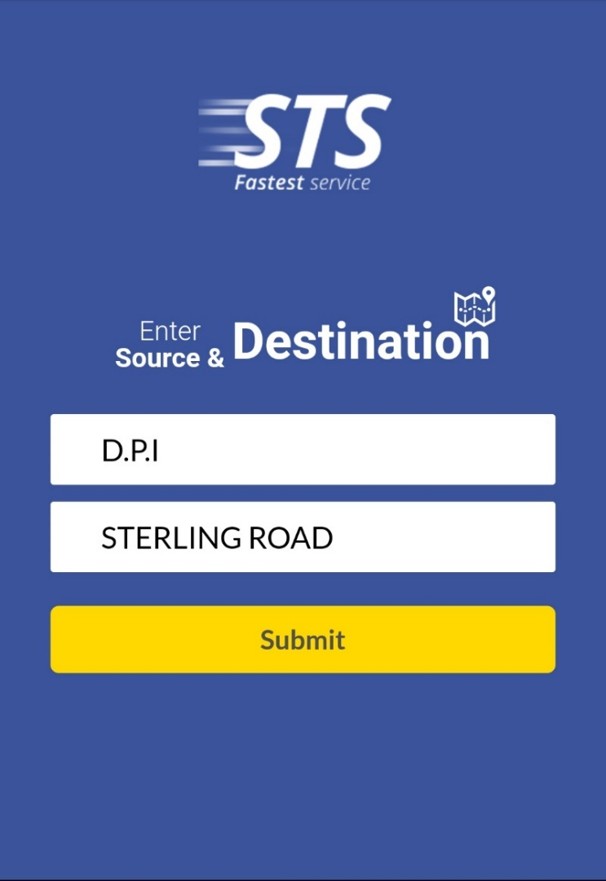
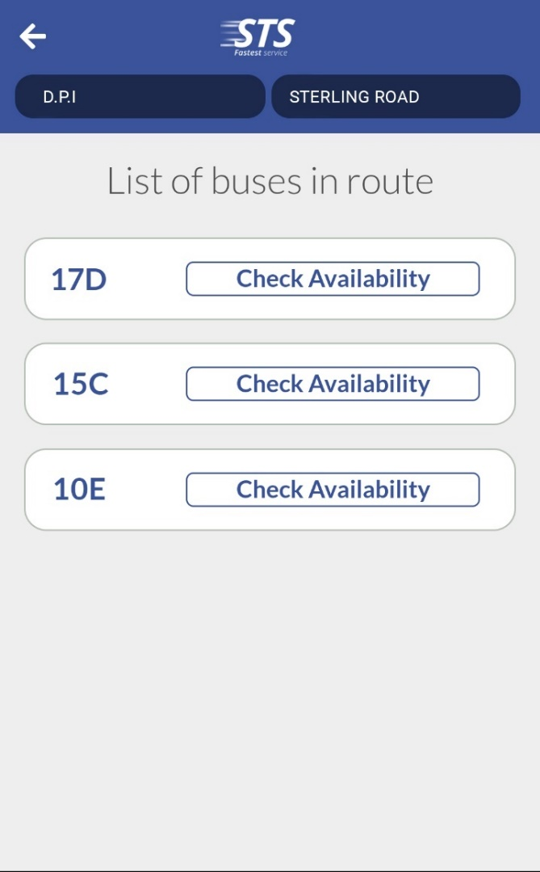
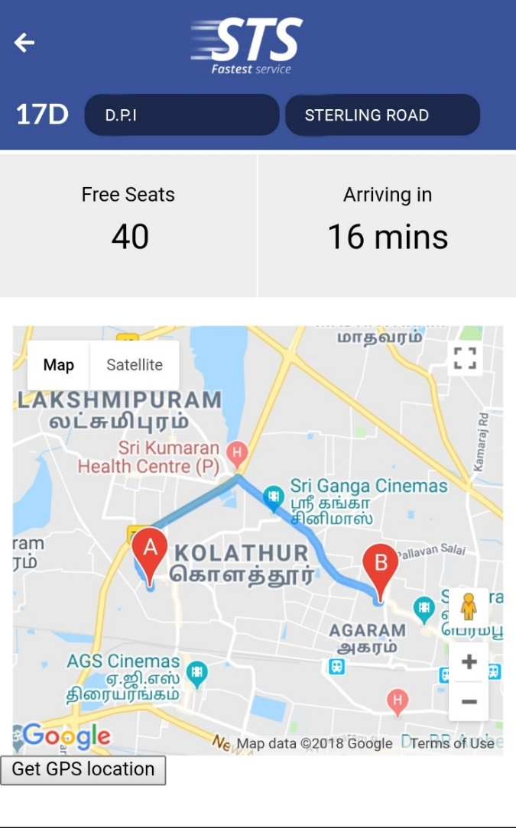
Screenshots

Slide 22
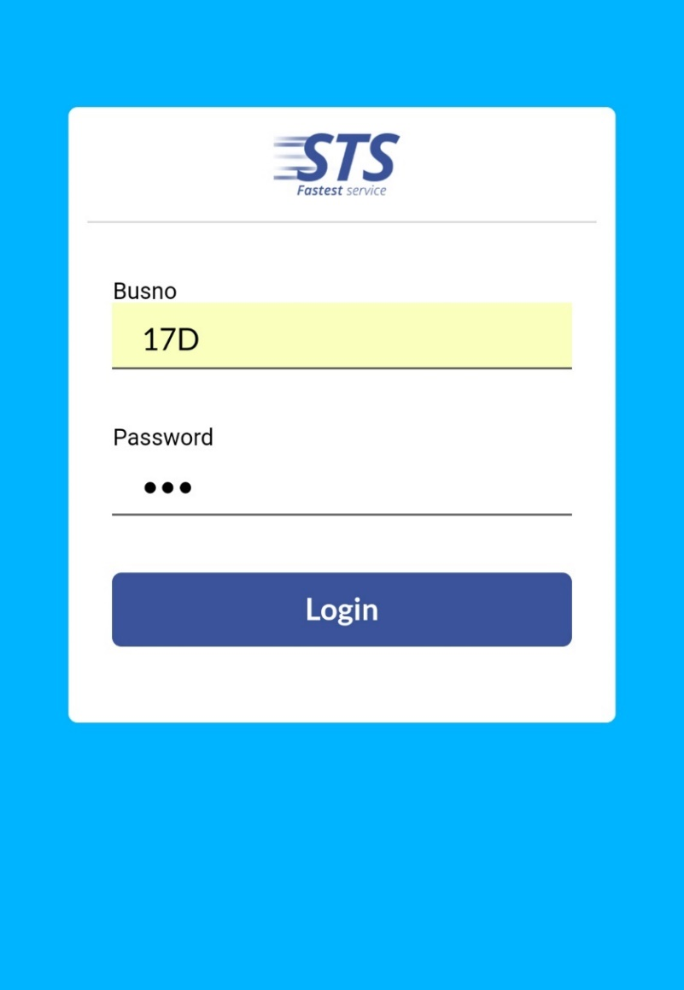
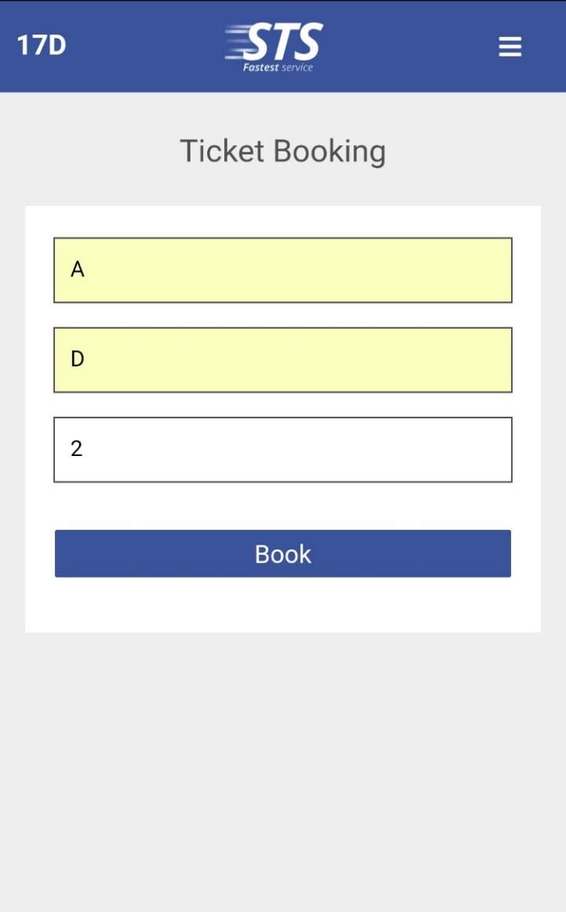
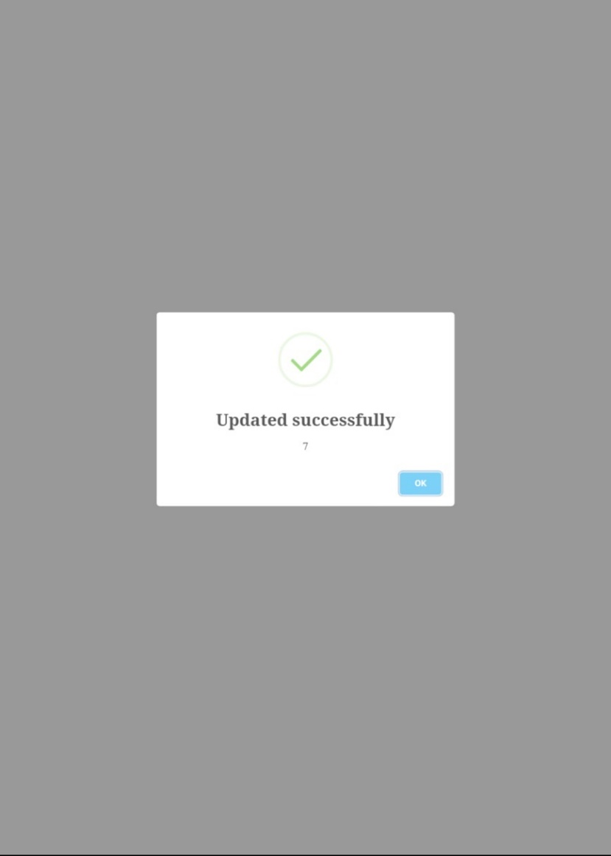
Screenshots

Slide 23
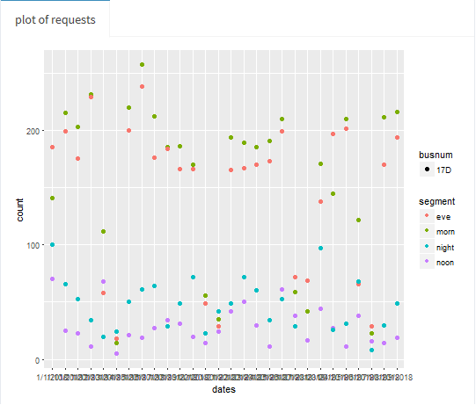
Results and Discussion
The scatter plot depicts the overall
count of passengers on each date
and is categorized by bus number and
segment of the day.

Slide 24
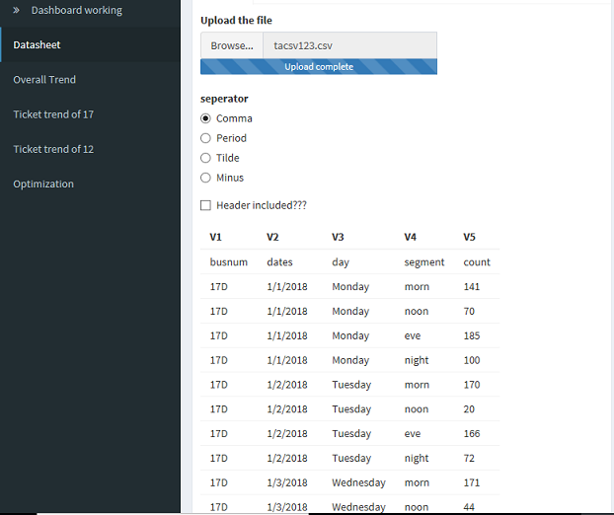
Results and Discussion
User can also view the dataset with its attribute by browsing through the directory.

Slide 25
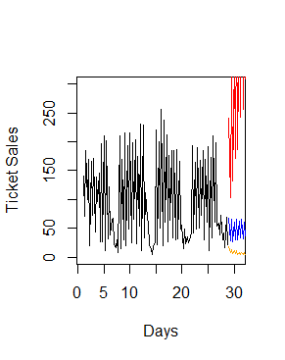
Results and Discussion
Sample trend prediction for
bus number 17D.

Slide 26
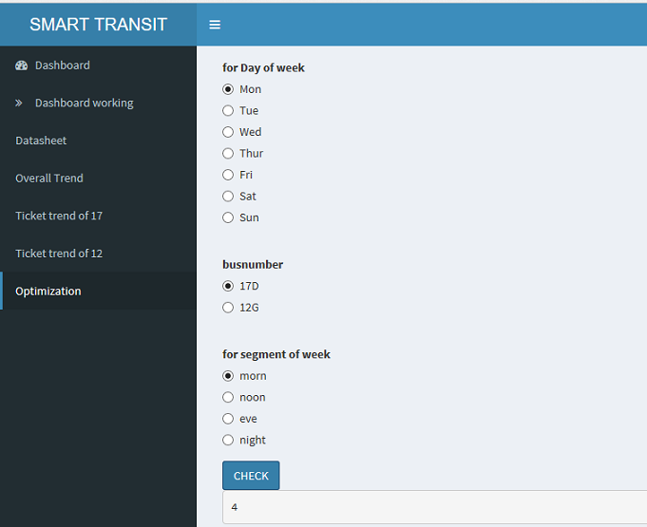
Results and Discussion
Optimized count of buses for each case is obtained by using Random Forest Regression.

Slide 27
Conclusion
We have developed a mobile application for Smart Transit System to help the commuters to take an informed choice about their travel and to optimize the number of buses using data mining algorithms, thereby optimizing the cost of operation, fuel consumption, pollution, traffic management and at the same time serving the commuters requirement.
The experiments conducted for the sample data set with the proposed method produced good results and predicted the optimized number of buses. The prediction made for optimizing the bus can be applied to a robust, scalable dataset.

Slide 28
Future Enhancements
Real time data analytics report on public displays
Multi Lingual support and localization of the apps and displays.
Integration support with other IoT devices for travel data enhancement

Slide 29
References
PAPERS
[1] Nouf Mohammad Al Shammary and Abdul Khader Jilani Saudagar, “Smart Transportation Application using Global Positioning System”, (IJACSA) International Journal of Advanced Computer Science and Applications, Vol. 6, No. 6, 2015.
[2] Hans-Arno Jacobsen, Kaiwen Zhang, Yingqi Yue, “Smart Phone Application for Connected Vehicles and Smart Transportation”, Middleware 2013 Posters and Demos Track, December 9-13, 2013, Beijing, China.
WEBSITES
http://www.mtcbus.org
https://www.ucananalytics.com
https://www.cranr.com
https://php.net
https://shiny.rstudio.com
http://www.stackoverflow.com

Slide 30
Thank You

